Slide 1
Updates 8/12/20
Akash Levy

Slide 2
Overview
Sweep plot for FPPV
Sweep plots for VWL and VBL
Retention distribution plots
Retention BER plot
ISPP optimization results
SDCFC optimization results
ISPP/FPPV evaluation on chip 1

Slide 3
Sweep Plots
Slope comparisons for different knobs, and FPPV results

Slide 4
Sweep Plots: FPPV VWL Chip 1

Slide 5
Sweep Plots: SET VWL

Slide 6
Sweep Plots: RESET VWL

Slide 7
Sweep Plots: SET VBL

Slide 8
Sweep Plots: RESET VSL

Slide 9
3bpc Algorithms
Optimization and experimental results

Slide 10
Resistance Ranges
 | Rmin | Rmax | Rwmin | Rwmax
Range 0 | N/A | 4.3k | N/A | 4.2k
Range 1 | 4.38k | 4.75k | 4.54k | 4.58k
Range 2 | 4.84k | 5.3k | 5.04k | 5.09k
Range 3 | 5.42k | 6.01k | 5.67k | 5.73k
Range 4 | 6.16k | 6.99k | 6.51k | 6.59k
Range 5 | 7.19k | 8.9k | 7.71k | 7.87k
Range 6 | 9.2k | 25k | 11.42k | 11.93k
Range 7 | 20k | N/A | 80k | N/A

Slide 11
ISPP Optimization Results

Slide 12
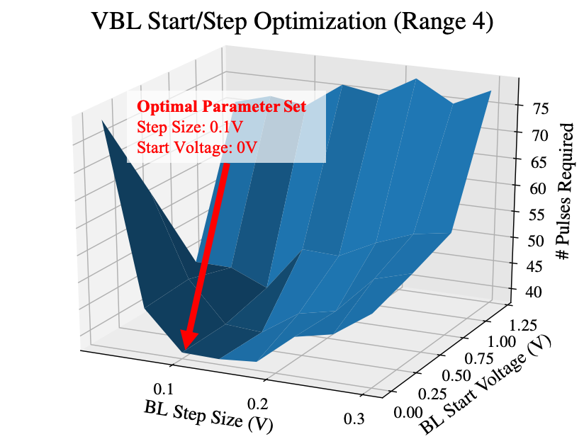
VBL Step Size Optimization

Slide 13
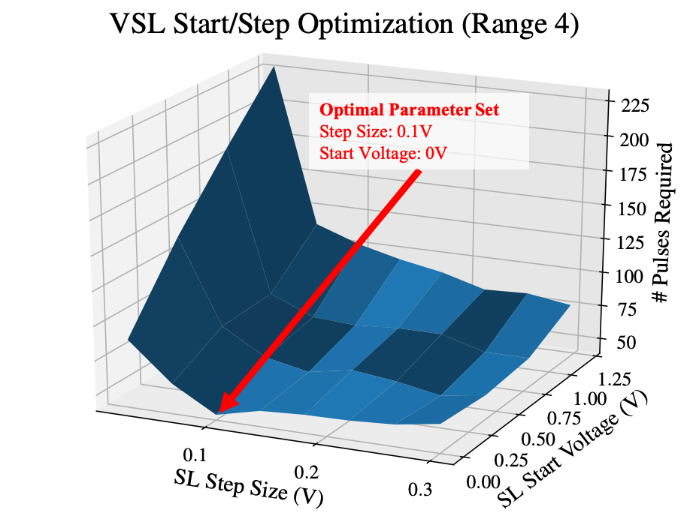
VSL Step Size Optimization

Slide 14
Optimization Parameters
 | VBL Start (V) | VBL Step (V) | VSL Start (V) | VSL Step (V)
Range 0 | 2 | 0.3 | N/A | N/A
Range 1 | 0 | 0.14 | 0 | 0.14
Range 2 | 0 | 0.1 | 0 | 0.1
Range 3 | 0 | 0.1 | 0 | 0.1
Range 4 | 0 | 0.1 | 0 | 0.1
Range 5 | 0 | 0.06 | 0 | 0.06
Range 6 | 0 | 0.06 | 0 | 0.1

Slide 15
Algorithm evaluation on 4 WLs: chip 1

Slide 16
Algorithm evaluation on 4 WLs: chip 2

Slide 17
3bpc algorithm evaluation on 4 WLs
Chip # | Cycles | SDCFC | ISPP | FPPV
1 | 300 | 36.44 | 86.10 | >90
2 | 300 | 35.88 | >90 | >90
1 | 8k | 35.19 | >90 | >90
2 | 8k | 35.53 | >90 | >90
Notes:
92.95 for chip 2 ISPP

Slide 18
2bpc Algorithms
Optimization and experimental results

Slide 19
Resistance Ranges
 | Rmin | Rmax | Rwmin | Rwmax
Range 0 | N/A | 5.10k | N/A | 5.00k
Range 1 | 5.38k | 6.48k | 5.77k | 6.01k
Range 2 | 6.93k | 12.00k | 8.51k | 9.31k
Range 3 | 20.00k | N/A | 80k | N/A

Slide 20
ISPP Optimization Results

Slide 21
VBL Step Size Optimization

Slide 22
VSL Step Size Optimization

Slide 23
Optimization Parameters
 | VBL Start (V) | VBL Step (V) | VSL Start (V) | VSL Step (V)
Range 0 | 2 | 0.3 | N/A | N/A
Range 1 | 0.6 | 0.18 | 0.6 | 0.26
Range 2 | 0.8 | 0.1 | 0.6 | 0.34

Slide 24
Algorithm evaluation on 4 WLs: chip 1

Slide 25
Algorithm evaluation on 4 WLs: chip 2

Slide 26
2bpc algorithm evaluation on 4 WLs
Chip # | Cycles | SDCFC | ISPP | FPPV
1 | 300 | 8.52 | 20.51 | 15.75
2 | 300 | 8.50 | 21.62 | 16.83
1 | 8k | 9.56 | >25 | >25
2 | 8k | 9.39 | >25 | >25

Slide 27
Retention
Distributions (empirical and predicted)

Slide 28
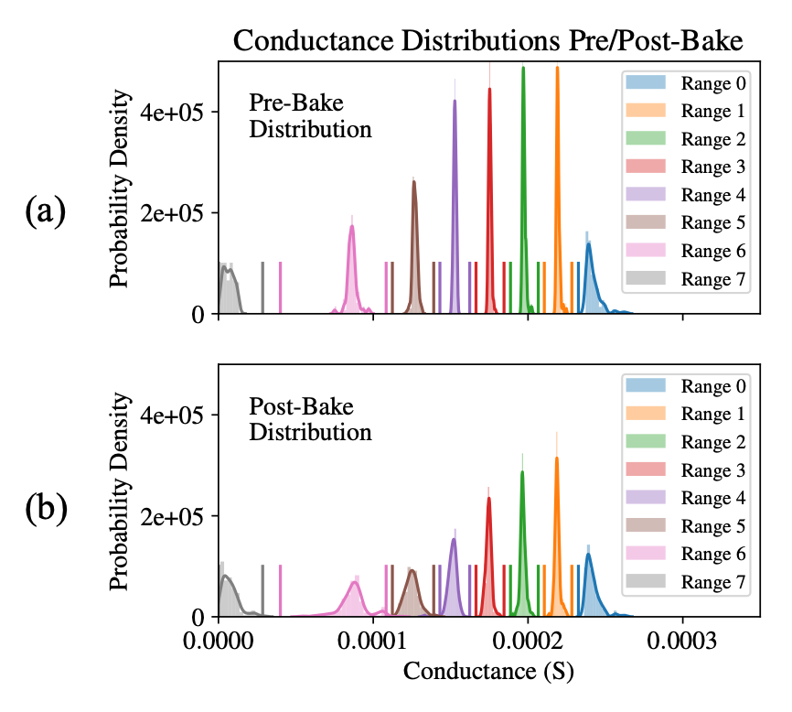
Combined Distribution Plot

Slide 29
Retention model plot

Slide 30
Retention BER plot

Slide 31
Comparisons
For establishing the context surrounding our work

Slide 32
Comparison Table (Full)
Ref. | Algo. Family | Array-Level | Bits-per-cell | # of Cells Measured | Efficient Ranges/Gaps | Endurance | Retention
This work | SDCFC | Yes | 3 | 16,384 | Yes | Yes | High-temp Array-level
[2] | FPPV | No | 2 | Single cell | No | No | None
[3] | ISPP | Yes | 2 | Single cell | No | Yes | High-temp Single-cell
[4] | FPPV | Yes | 3 | 7,746 | Yes | Yes | None
[11] | ISPP | Yes | 2 | 4,096 | No | Yes | High-temp Array-level
[12] | ISPP | No | 4 | Single cell | No | No | Low-temp Single-cell

Slide 33
Comparison References
Toward Reliable Multi-Level Operation in RRAM Arrays: Improving Post-Algorithm Stability and Assessing Endurance/Data Retention
Optimized Method for Low-Energy and Highly Reliable Multibit Operation in a HfO2-Based Resistive Switching Device
Fully “Erase-free” Multi-Bit Operation in HfO2‐Based Resistive Switching Device
A multi-level 40nm WOx resistive memory with excellent reliability
Demonstration of low power 3-bit multilevel cell characteristics in a TaOx-based RRAM by stack engineering
A novel program- verify algorithm for multi-bit operation in HfO2 RRAM
Four-bits-per-cell operation in an HfO2-based resistive switching device

Slide 34
Backup
Things we will show only if reviewers or co-authors ask

Slide 35
3bpc Pre-Optimization Parameters
 | VBL Start (V): Seed | VBL Step (V): Seed | VSL Start (V) | VSL Step (V)
Range 0 | 0.4 | 0.04 | N/A | N/A
Range 1 | 0.4 | 0.04 | 0.6 | 0.18
Range 2 | 0.4 | 0.04 | 0.2 | 0.22
Range 3 | 0.4 | 0.04 | 0.4 | 0.14
Range 4 | 0.4 | 0.04 | 0.4 | 0.14
Range 5 | 0.4 | 0.04 | 0.4 | 0.14
Range 6 | 0.4 | 0.04 | 0.4 | 0.14

Slide 36
2bpc Pre-Optimization Parameters
 | VBL Start (V): Seed | VBL Step (V): Seed | VSL Start (V) | VSL Step (V)
Range 0 | 2 | 0.3 | N/A | N/A
Range 1 | 0 | 0.04 | 0 | 0.16
Range 2 | 0 | 0.04 | 0 | 0.1

Slide 37
BER Plot at 100 Pulses

Slide 38
Retention BER plot full

Slide 39
Combined Pre/Post-Bake Distribution Plot
(a)
(b)

Slide 40
VBL Optimization
Optimal Parameter Set
Step Size: 0.1V
Start Voltage: 0V

Slide 41
VSL Optimization 1

Slide 42
VSL Optimization 2
Optimal Parameter Set
Step Size: 0.1V
Start Voltage: 0V

Slide 43
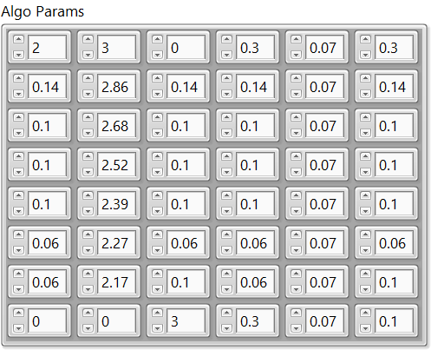
Algorithm Parameters

